Slide 1

OVS Manager APP
--OVS and Openflow Implementation
Group 4
Mao Jianwei Zhang Peng
Jin Ling Ma Tianfeng
#Hackathon
Notes:
Good Morning, everybody. It’s really an honor to share our experience here. First of all, let me introduce our group member: Our leader, Mao Jianwei from BUPT, Ma Tianfeng from China Unicom, Zhang Peng and I from China Telecom. We chose the 7th Subject OVS and Openflow and develop an application call ovs manager to fulfill the requirements in this subject.

Slide 2
Agenda
Project Overview
Extensions and Features
Conclusion
Notes:
Here’s a simple agenda of our presentation. We’ll take an overview on the project first, and then focus on the extensions and features in our application. And we’ll make a conclusion to our work.

Slide 3
Work Division
Discussion & Design:
All members
Programming:
Mao Jianwei
Zhang Peng
Documentation and Presentation:
Jin Ling
Ma Tianfeng
Notes:
This is our work division. All of us involved in the discussion and design. Fortunately, there are two talented programmers in our group. They cooperated in the coding part while Ma Tianfeng and I prepared these slides.

Slide 4

Project Overview
Basic function implementation:
Develop a new App --- OVS Manager
Use CLI to create OVS switch
Create a pipeline --- OVS Pipeline
Add subject flows to OVS
Internal App:
OVS Manager
Build our own ONOS App.
Create “create-bridge” command and develop a new service.
ONOS controller
Create our own pipeline.
Develop a listener to modify flow table when the DEVICE_ADD event happens.
OVS
Using Git for coding teamwork
Notes:
Since we’re the second team to introduce this subject, I wouldn’t spend much time on explation of the basic functions. What we’ve done is:
….
And the two programmers used git for coding teamwork.

Slide 5
Create OVS
OVS Manager
createHandler()
DriverService
handler.behaviour()
BridgeConfig
OvsdbBridgeConfig
addBridge()
OvsdbClientService
Notes:
One of the key point in this subject is how to create an OVS-bridge. OVS Manager uses createHandler() in DriverService to obtain a handler. Then with the help of BridgeConfig and OvsdbClientService, we can add a new OVS-bridge to ONOS.

Slide 6
OVSPipeline
Table 0: When priority is 60000, match type is ip & source ip is 10.0.0.0/24 then action is to configure dst mac as ff:ff:ff:ff:ff:ff and goto Table 1;
Table 1: When priority is 60000, dst mac is ff:ff:ff:ff:ff:ff then action is to drop the packets.
Location: org.onosproject.driver.pileline. OVSPipeline
Table 0: L3fwd
……
Matched flow entry N
……
Default:Table-miss, drop
Table 1: MAC
flow entry 1
……
Default:Table-miss, drop
Packets
Notes:
Another key point is to write our own pipeline. According to the instructions, we can figure out there are two tables. One is Table0 which is an L3fwd table, and the other is Table1, a MAC table. We implemented the pipeline in the package org.onosproject.drivr.pileline.

Slide 7
Extended Functionality
1. Create multi-type OVS, and push variant flow entries after creation.
2. Implement deleting OVS besides creating.
3. Develop CLI command for showing switch information.
4. Support cluster deployment.
Notes:
We know that this subject is a very abstracted situation. So we considered more complicated ones and added some extensions. They are listed on this slide.

Slide 8
Design & Coding Consideration
1. Use different methods to get OVSDB connection in different phase
When the app is activated, search the connection already set up.
If no connection found, try to catch the connection from DeviceListener.
2. Use the Stream feature of Java 8
Filter specific type of OVS.
3. Follow ONOS Code-Style
Notes:
We also had some special considerations on the design and coding part.

Slide 9
Architecture
Notes:
We provide an Interface called OvsManageService and implement it with Class OVSManageManager which uses four original services in ONOS, including ,,,. As mentioned before, we wrote our own OVSPipeline and implemented 3 commands.

Slide 10
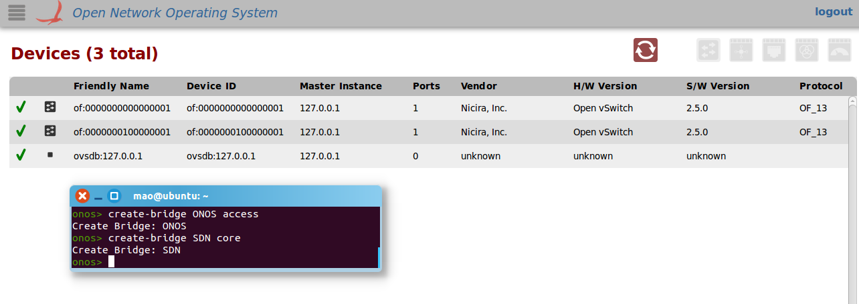
Feature 1 : Create multi-type OVS
Command: create-bridge [bridge_name] [bridge_type]
Use the specific position of Device Uri to identify the type.
Increase device uri number during creation with AtomicCounter.
Notes:
Now let’s take a look at our 4 features. Feature 1, use command create-bridge bridge_name bridge_type to create multi-type OVS-bridges. We use …

Slide 11
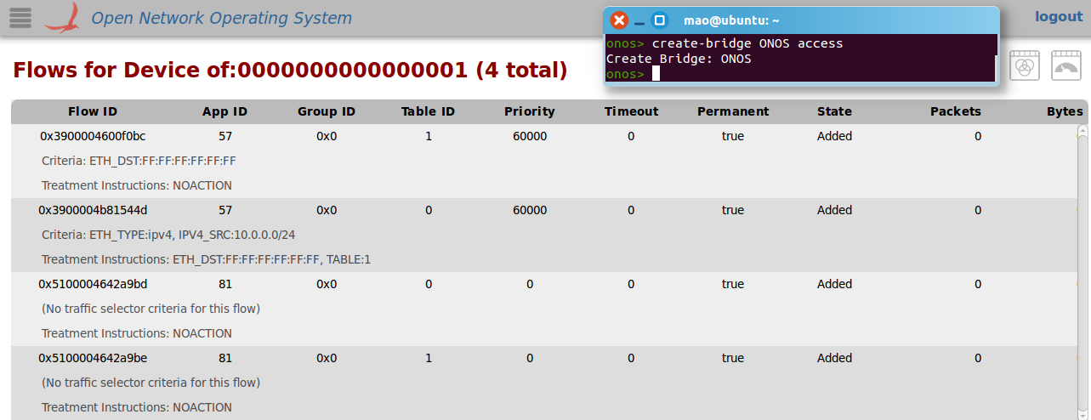
Feature 1 : Variant default flow entries--ACCESS Switch
Use the specific position of Device Uri, to identify the type.
Increase device uri number during creation with AtomicCounter.
Notes:
We impelented to two types of bridges: ACCESS and CORE.

Slide 12
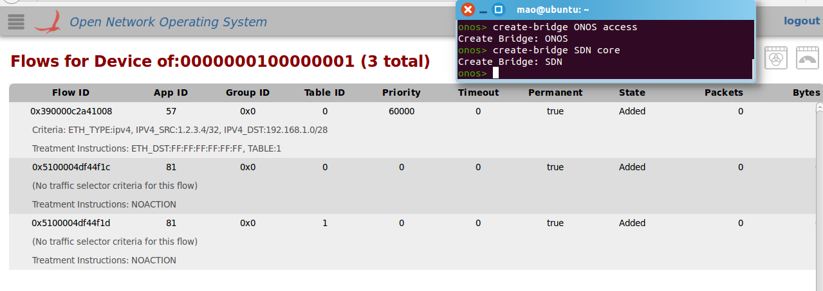
Feature 1 : Variant default flow entries--CORE Switch
Use the specific position of Device Uri, to identify the type.
Increase device uri number during creation with AtomicCounter.

Slide 13
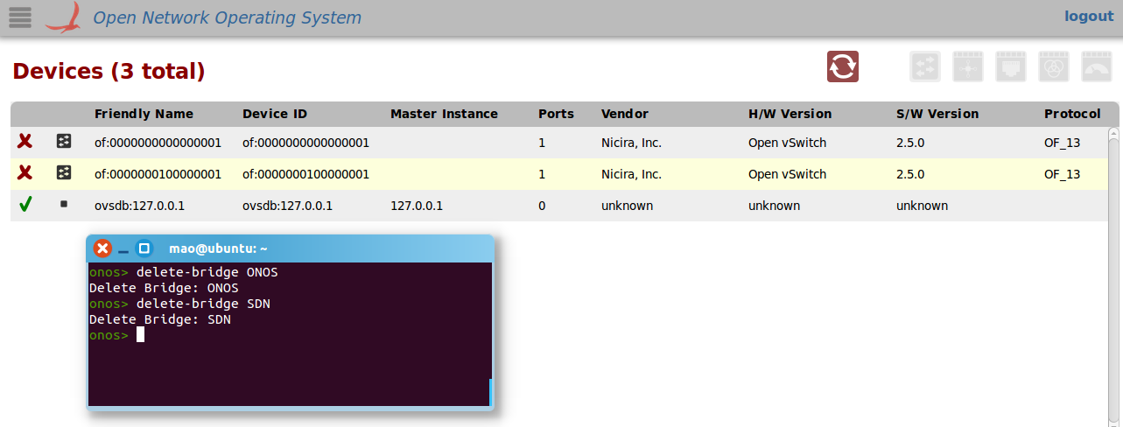
Feature 2 : Delete OVS Switch
Command: delete-bridge [bridge_name]

Slide 14
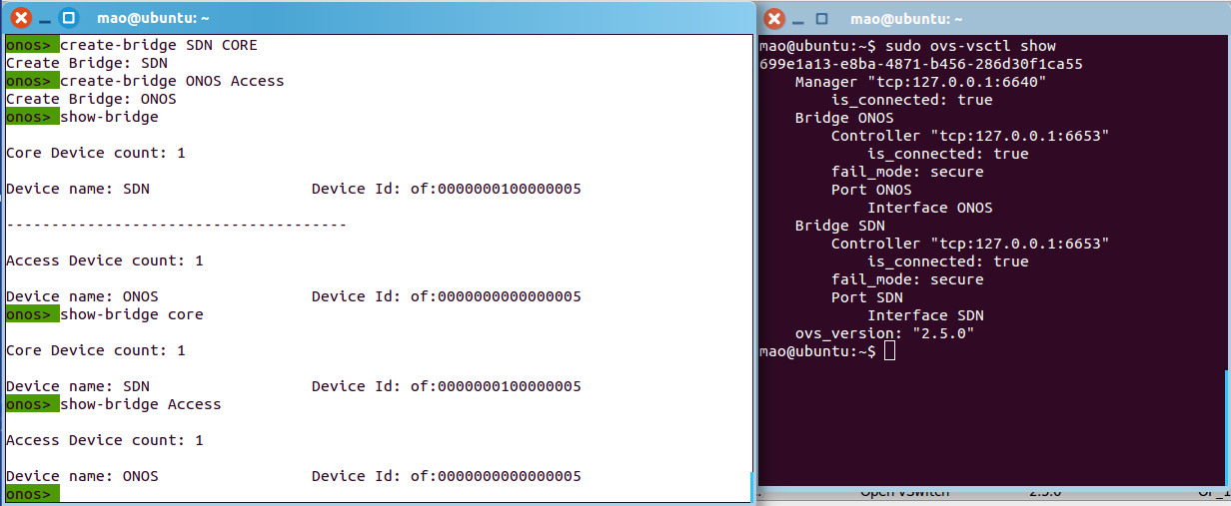
Feature 3 : Show Switch Information
Command: show-bridge [bridge_type]
Show all type of OVS without any parameter
Show specific type of OVS when type is provided

Slide 15
Feature 4 : Support cluster deployment
Maintain Distributed and Atomic variables with the help of StorageService,
App can adapt to cluster deployment.
<String>setBuilder()
atomicCounterBuilder()
OVS Manager
StorageService
DistributedSet<String>
AtomicCounter

Slide 16
Conclusion
Four Extended Functionality, Two Special Design
Learn how to create and delete OVS by ONOS interface.
Learn how to adapt our App to Cluster deployment.
Learn how to Create and Register our own Device Pipeline.
Learn how to use Flow Objectives.
Find some bugs of ONOS.
Above all, a great experience of teamwork ☺

Slide 17
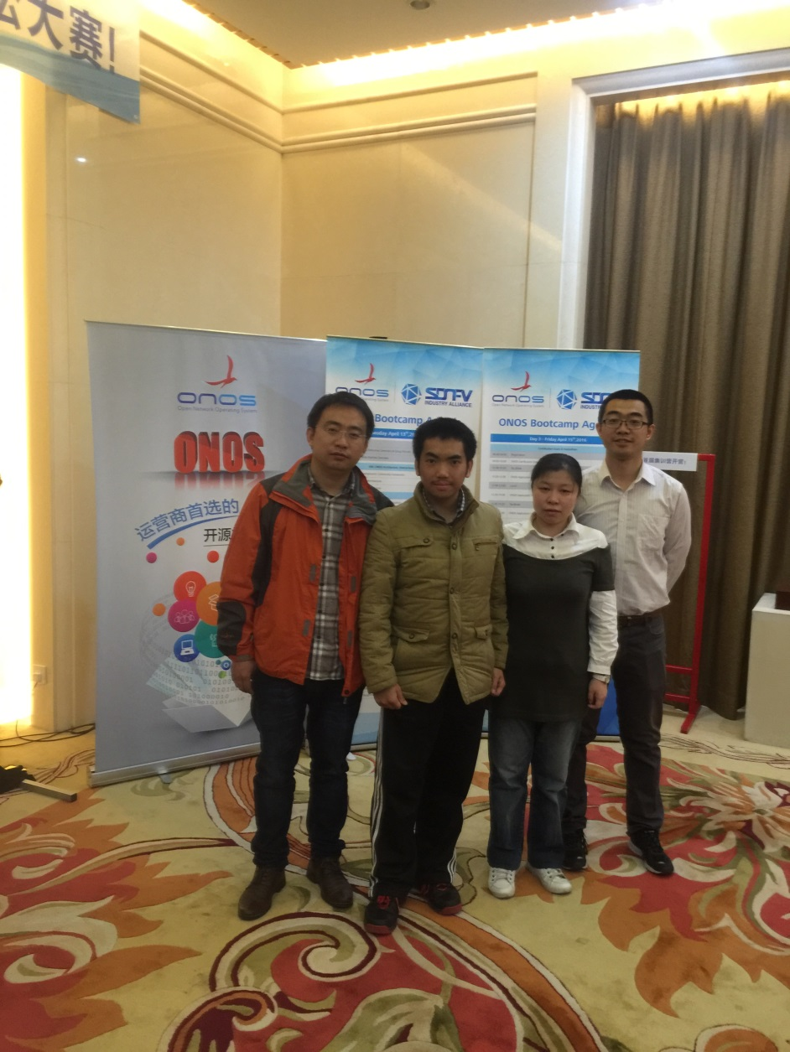
Thank you very much !
Group 4
Mao Jianwei Zhang Peng
Jin Ling Ma Tianfeng
#Hackathon

